Slide 1
Introduction to Energy Efficient Design
Presented to:
Energy Design Conference Preconference Workshop
Duluth, Minnesota
February 20, 2017
Presented by:
Rebecca Ellis, PE, LEED AP BD+C, CCP, CPMP, CxA
President
Questions & Solutions Engineering, Inc.

Slide 2
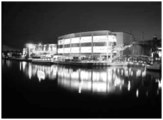
Outline
Current State of Energy Systems Design
Implications for Energy Conservation
Costs
Barriers to Improvement

Slide 3
Introductions
Presenters
Attendees
Minnesota Power Representatives

Slide 4
Current State of Energy Systems Design
“Efficient Design” vs. “Energy Efficient Design”
Designer Selection Process
  Architects Selected by Owners
  Engineers selected by Architects
  Fixed fee
  Commodity perception
  Necessary evil
Notes:
Current process is “efficient” for project team but not “energy efficient” for owner.
NOTE: A “worst case” very cynical perspective – exaggerated for the purposes of this presentation. Not representative of all design professionals or projects.
Architects shield owner’s from engineers

Slide 5
Current State of Energy Systems Design
Project Design Team
  Architect
  Engineers
  Owner’s Project Manager/Representative
  Future Users
  Construction Manager (optional)
  Future Building Operators (optional)

Slide 6
Current State of Energy Systems Design
Engineering Design Process
  Building and space types definition by Architect
  Energy systems schematic design narrative
    Based on last “similar” project
    Corporate standard template
  Design Development
    Block load calculations
    Coordination with Architect for space requirements
    Rough lay-out of equipment and major distribution routes

Slide 7
Current State of Energy Systems Design
Engineering Design Process (cont’d)
  Construction Documents
    Delay as long as possible due to ever-changing Architectural plans
    Detailed load calculations
    Final equipment selections, layout, and distribution sizing
    Corporate standard specifications
      O&M training requirements
      O&M documentation requirements
      Punchlist & Closeout

Slide 8

Current State of Energy Systems Design
Engineering Design Process (cont’d)
  Operations & Maintenance Planning
    Design engineers with little or no systems operations experience
    Industry standard boilerplate O&M training requirements
    Industry standard boilerplate O&M documentation requirements
Notes:
Industry standard boilerplate specifications = common knowledge of what is expected = developed by designers
O&M Manuals as a closeout punch list item
O&M Training only if requested and at the contractors’ convenience

Slide 9
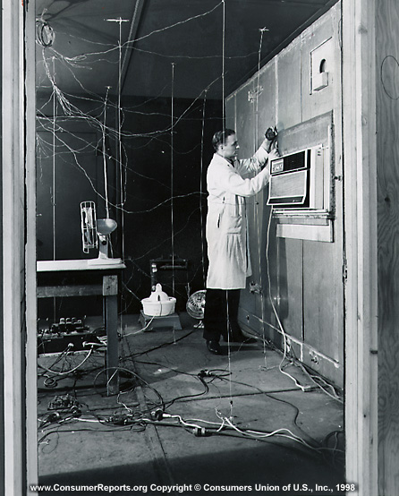
Current State of Energy Systems Design
Engineering Design Process (cont’d)
  Bid Document Addenda
    Final coordination details
    Control system design
  Low Bidder Selected
Notes:
Final coordination by addenda is the result of Architects ever-changing plans – even up to last minute of Construction Documents.

Slide 10
Current State of Energy Systems Design
Project Timeline
Owner Schedule Constraints
  Financing
  Domino affect of relocating people
  End of leases

Slide 11
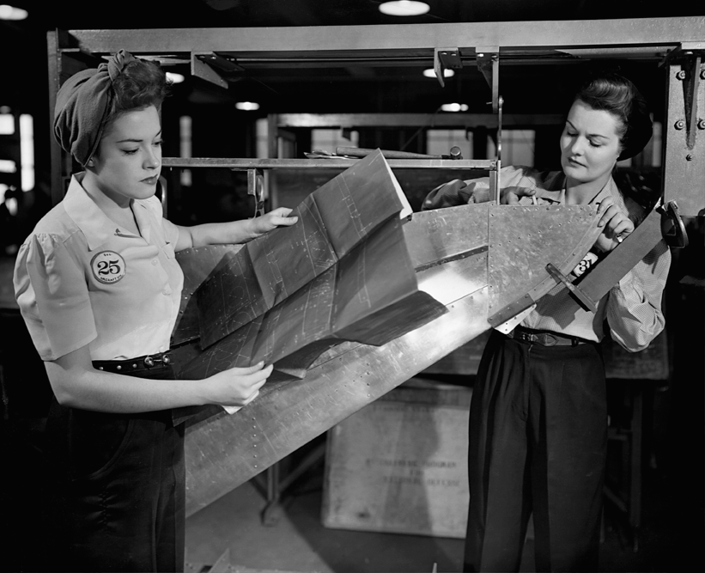
Current State of Energy Systems Design
Objective of Design Process?
  Drawings and specifications for use in bidding
  Not so much concern about what comes next

Slide 12
Current State of Energy Systems Design
Summary
  Minimal or no analysis of alternate systems
  Architectural-Engineering integration limited to space requirements
  Minimal or no systems operations and integration consideration
  No meaningful, enforceable operations and maintenance planning

Slide 13
Implications for Energy Conservation
Minimum Energy Code Compliance
Common Systems Potentially Familiar to Building Operators
  Most likely to be operated as intended – just by chance, not by planning
Frustrated Energy-Conscious Owners
  Inadequate or non-existent design phase comparative systems analysis
Design Engineers Familiar with Equipment & Systems
  Lower risk of design errors, change orders, and/or post-construction troubleshooting
Notes:
Most likely to be operated as intended = reasonable likelihood of achieving close to minimum energy code consumption
Minimal design risk = lowered risk of INCREASED ENERGY CONSUMPTION due to an energy efficient system being designed, installed, or controlled inappropriately

Slide 14
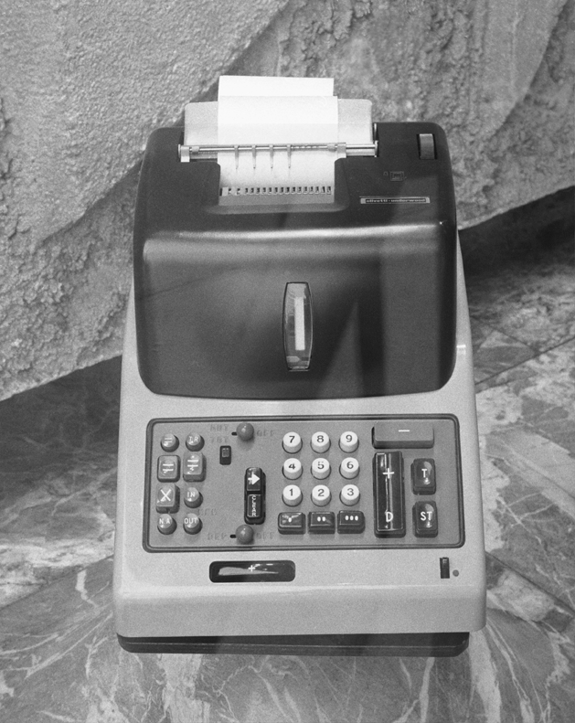
Costs
Design Fees
Procurement & Installation Costs
Troubleshooting Costs
Remediation Costs
Energy Costs
Notes:
Lot of emphasis on Design Fees and Procurement/Installation with little Design Phase consideration of Troubleshooting & Remediation if the Design Phase is not robust.
Energy Costs are hit-and-miss on how deeply and meaningfully they are taken into consideration during Design.

Slide 15
Barriers to Improvement
Commodity Design Engineering Fees
Design Engineers Unfamiliar with New Systems
Rushed Design Process
Lack of Experience Evaluating Energy System Options
Lack of Experience Operating Building Systems
High Risk/Low Reward for Innovative Design
Notes:
Design Engineers Unfamiliar with New Systems
Design assistance from equipment vendors
May not have full understanding of how to design around and integrate new equipment

Slide 16
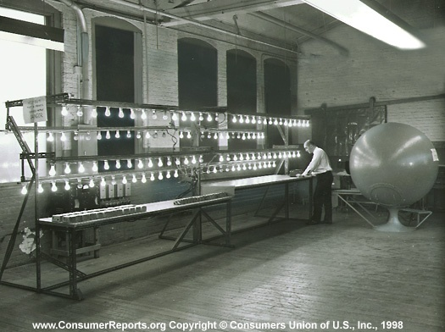
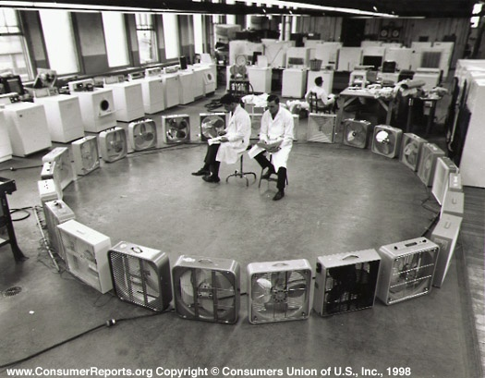
Preconference Workshop Agenda
Lighting & Lighting Controls Design
HVAC & Controls Design
Case Studies
Lessons Learned & Best Practices

