Slide 1
Notes:
Section slide
On the iclicker toolbar, click on the down arrow and click to turn off “Anonymous polling.”

Slide 2
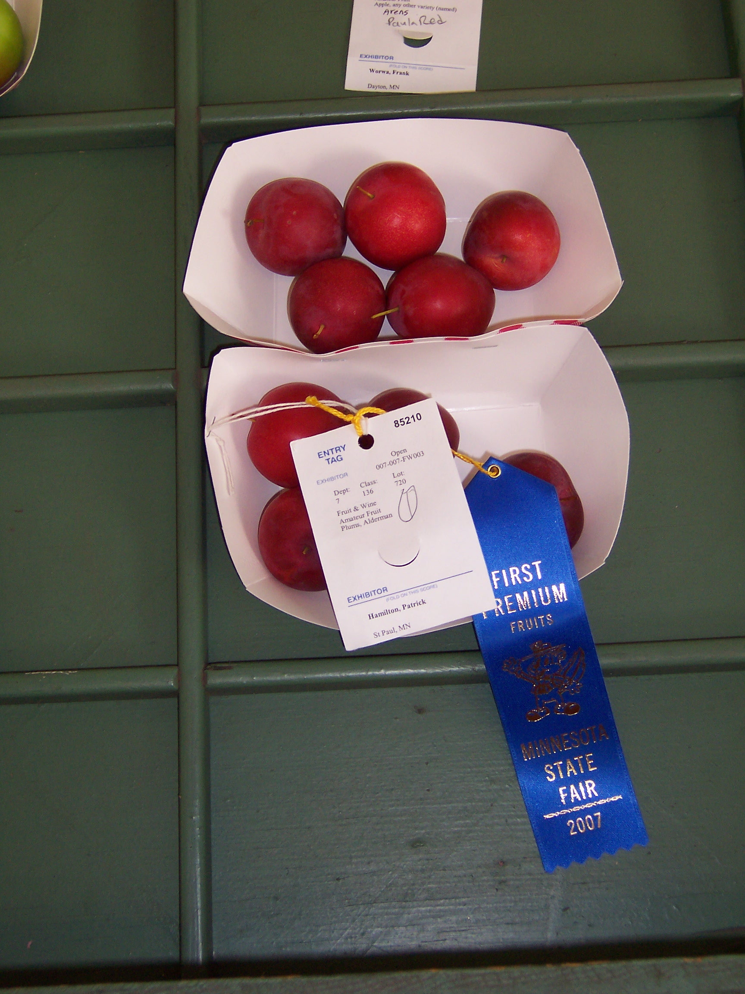
Notes:
Section slide
On the iclicker toolbar, click on the down arrow and click to turn off “Anonymous polling.”

Slide 3
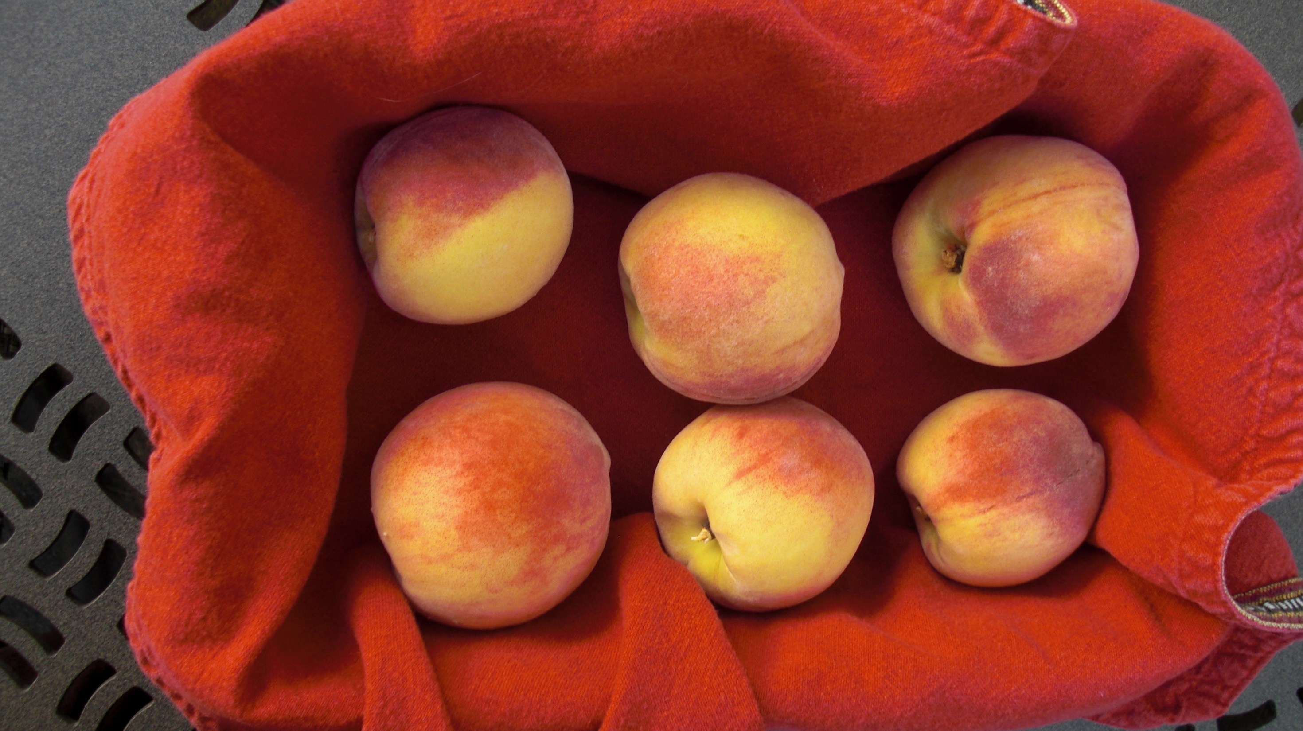
Notes:
Section slide
On the iclicker toolbar, click on the down arrow and click to turn off “Anonymous polling.”

Slide 4
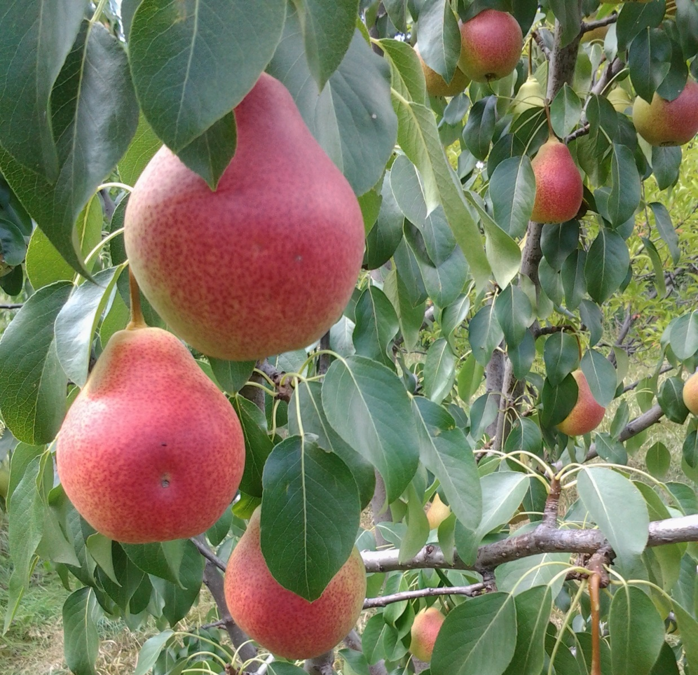
Notes:
Section slide
On the iclicker toolbar, click on the down arrow and click to turn off “Anonymous polling.”

Slide 5
Notes:
Section slide
On the iclicker toolbar, click on the down arrow and click to turn off “Anonymous polling.”

Slide 6
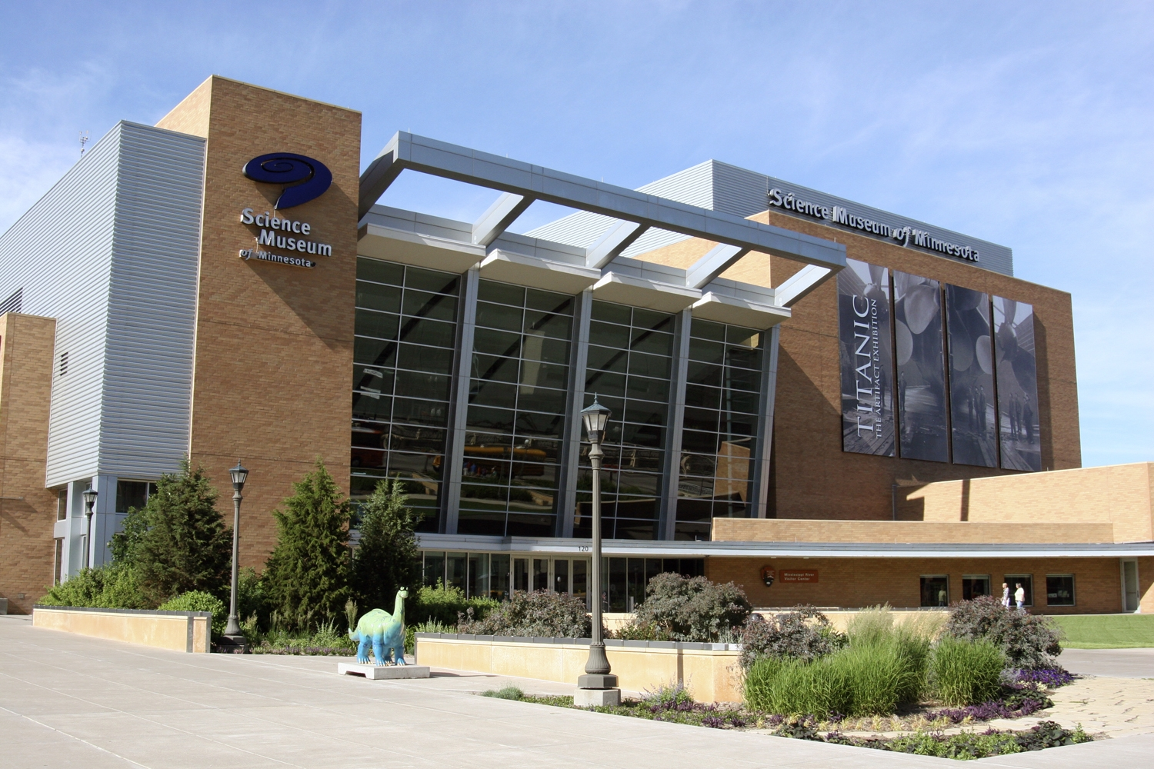
Notes:
Section slide
On the iclicker toolbar, click on the down arrow and click to turn off “Anonymous polling.”

Slide 7
Notes:
Section slide
On the iclicker toolbar, click on the down arrow and click to turn off “Anonymous polling.”

Slide 8
Notes:
Section slide
On the iclicker toolbar, click on the down arrow and click to turn off “Anonymous polling.”

Slide 9
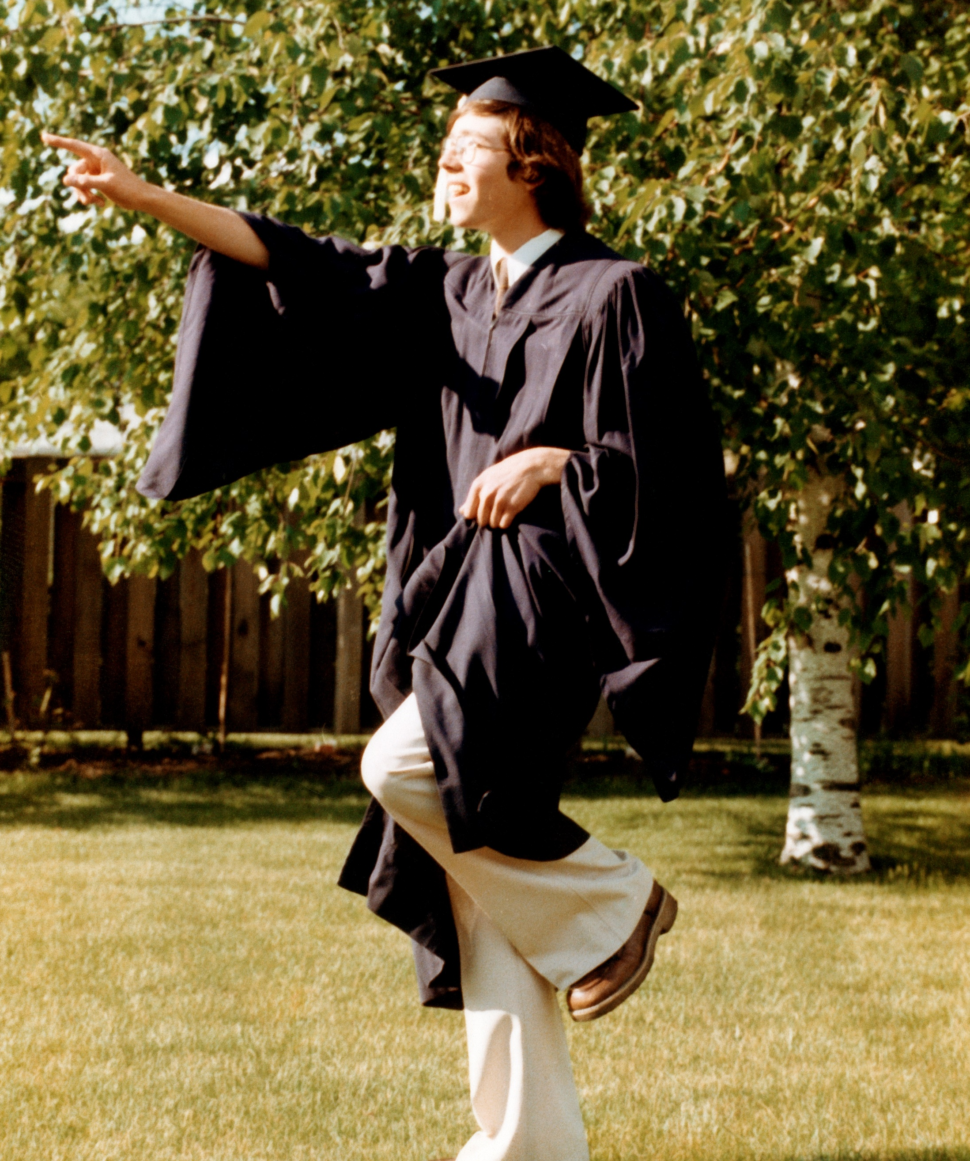

Slide 10
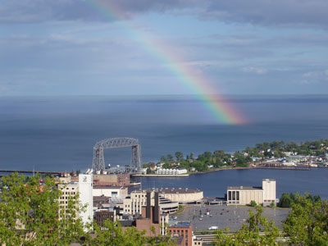
Notes:
Section slide
On the iclicker toolbar, click on the down arrow and click to turn off “Anonymous polling.”

Slide 11
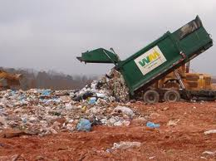
Notes:
Section slide
On the iclicker toolbar, click on the down arrow and click to turn off “Anonymous polling.”

Slide 12
Notes:
Section slide
On the iclicker toolbar, click on the down arrow and click to turn off “Anonymous polling.”

Slide 14
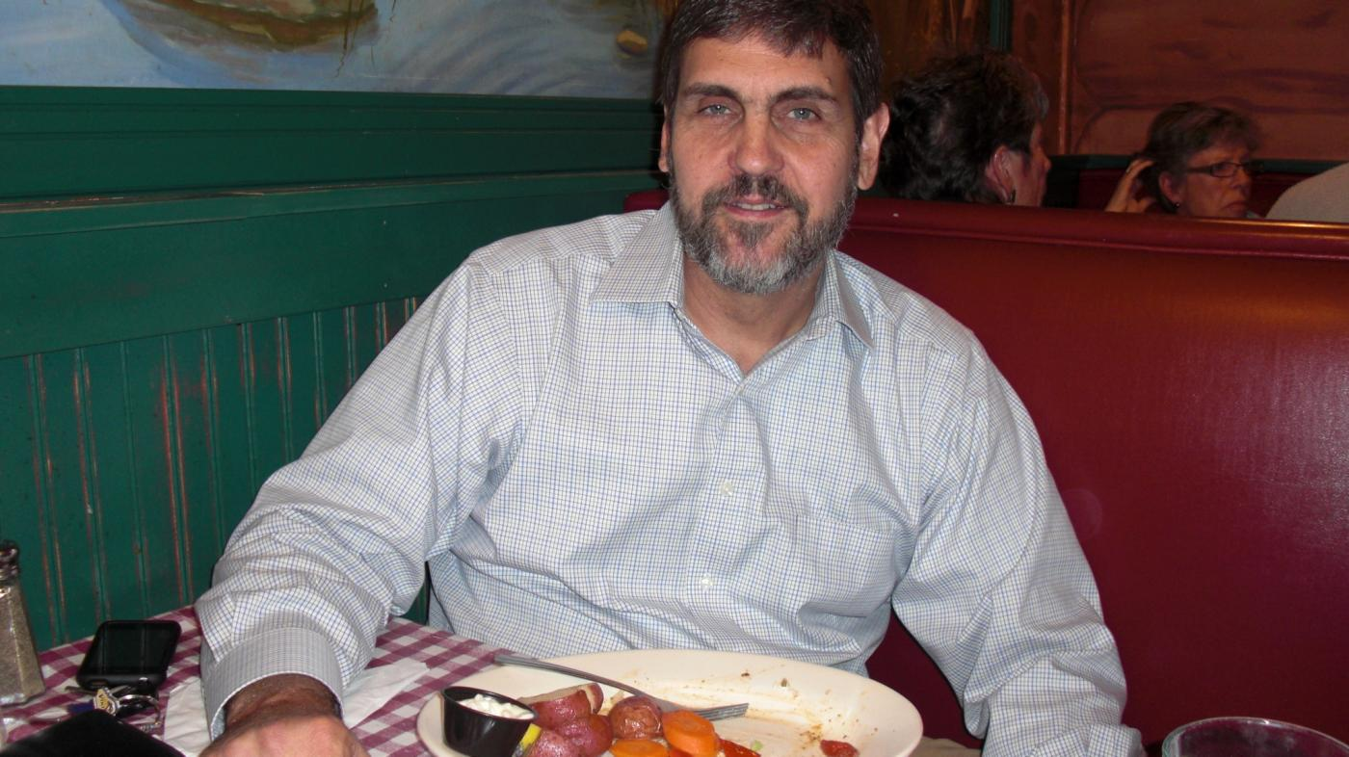

Slide 15
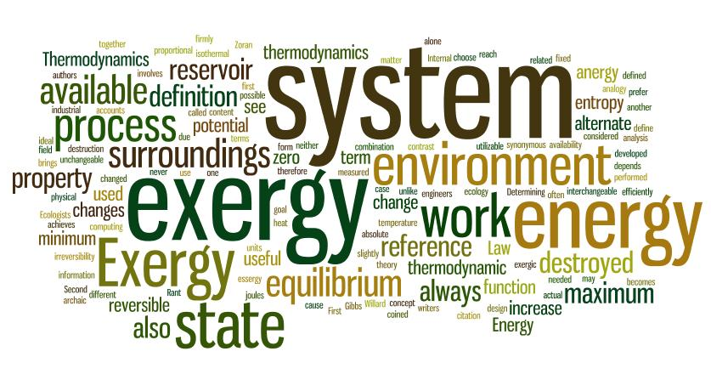

Slide 17
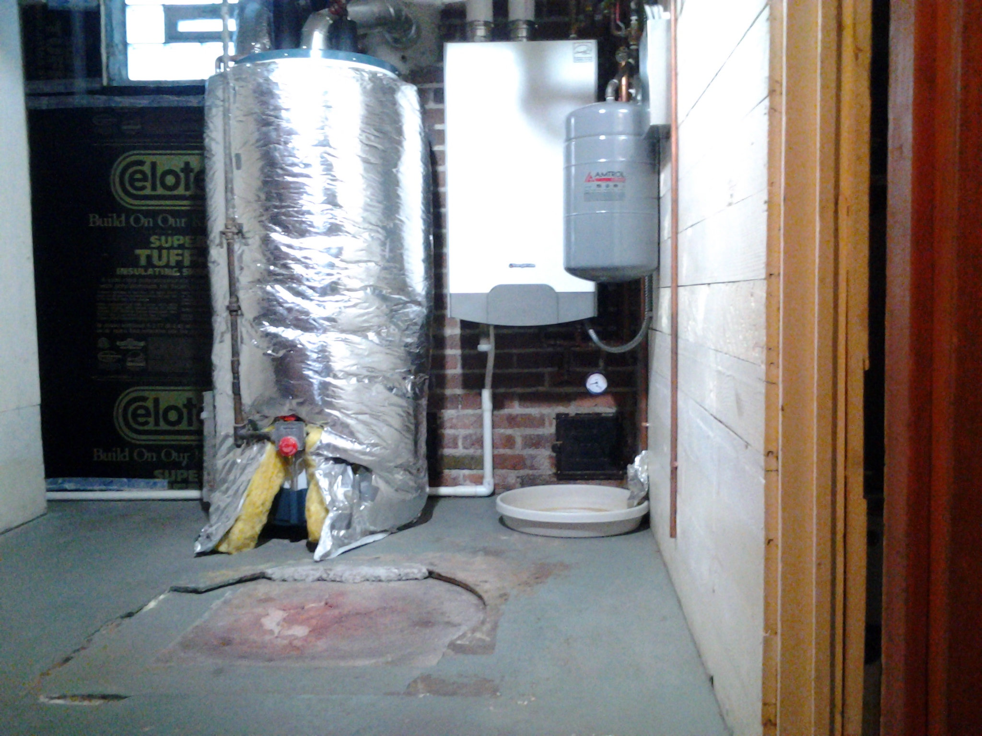

Slide 18
3,542ºF

Slide 19
3,542ºF
120ºF
50ºF

Slide 22
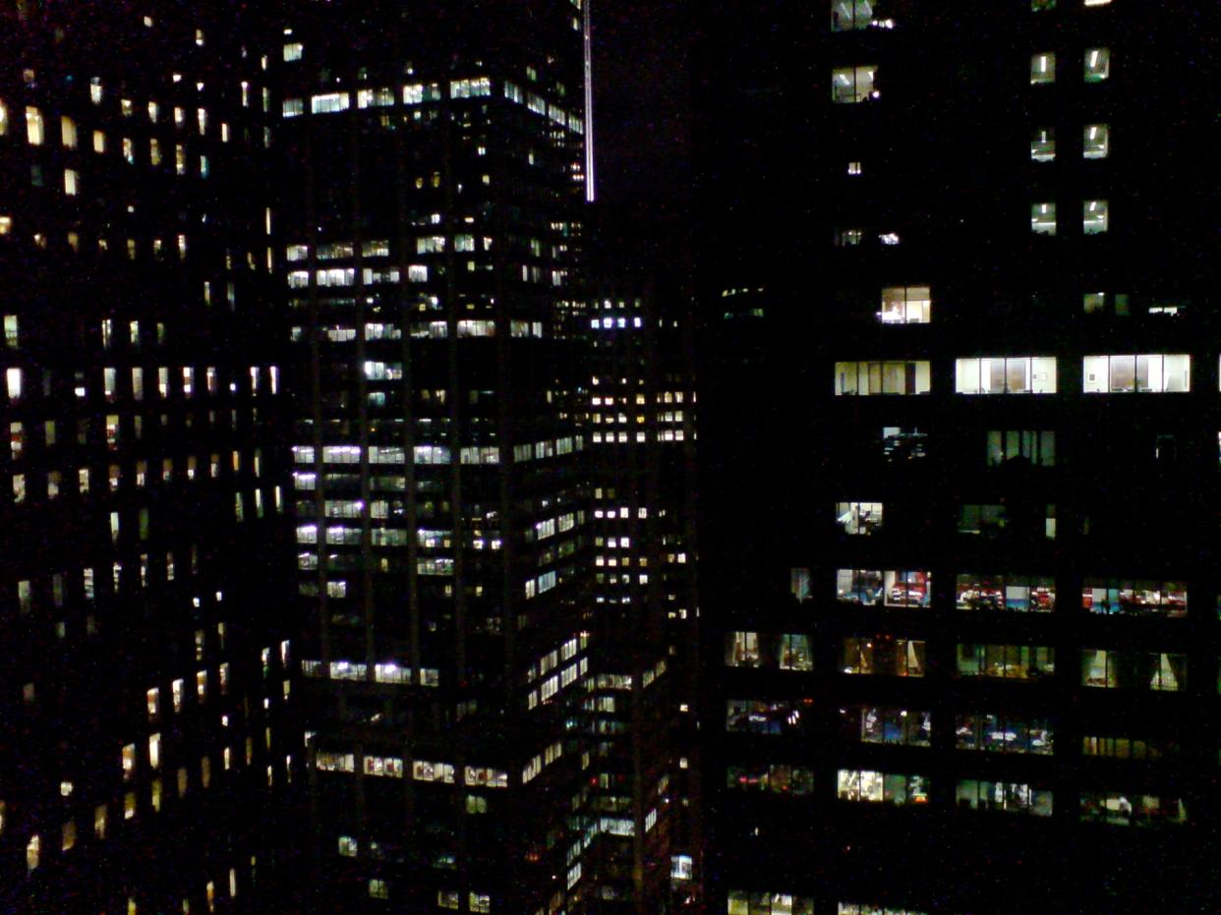

Slide 23
6,348,000 kWh/yr.

Slide 24
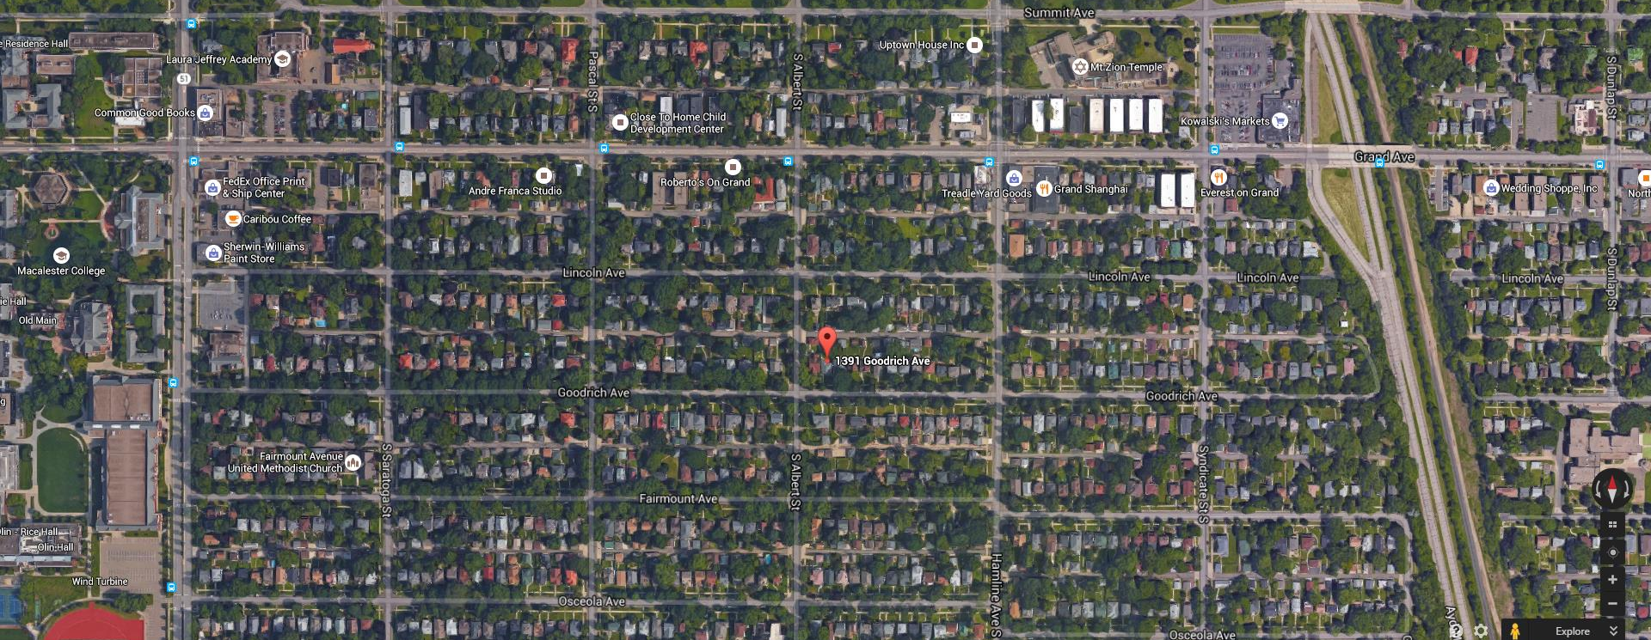

Slide 25
BTUs

Slide 26
BTUs
Exported/yr.
Imported/yr.

Slide 27
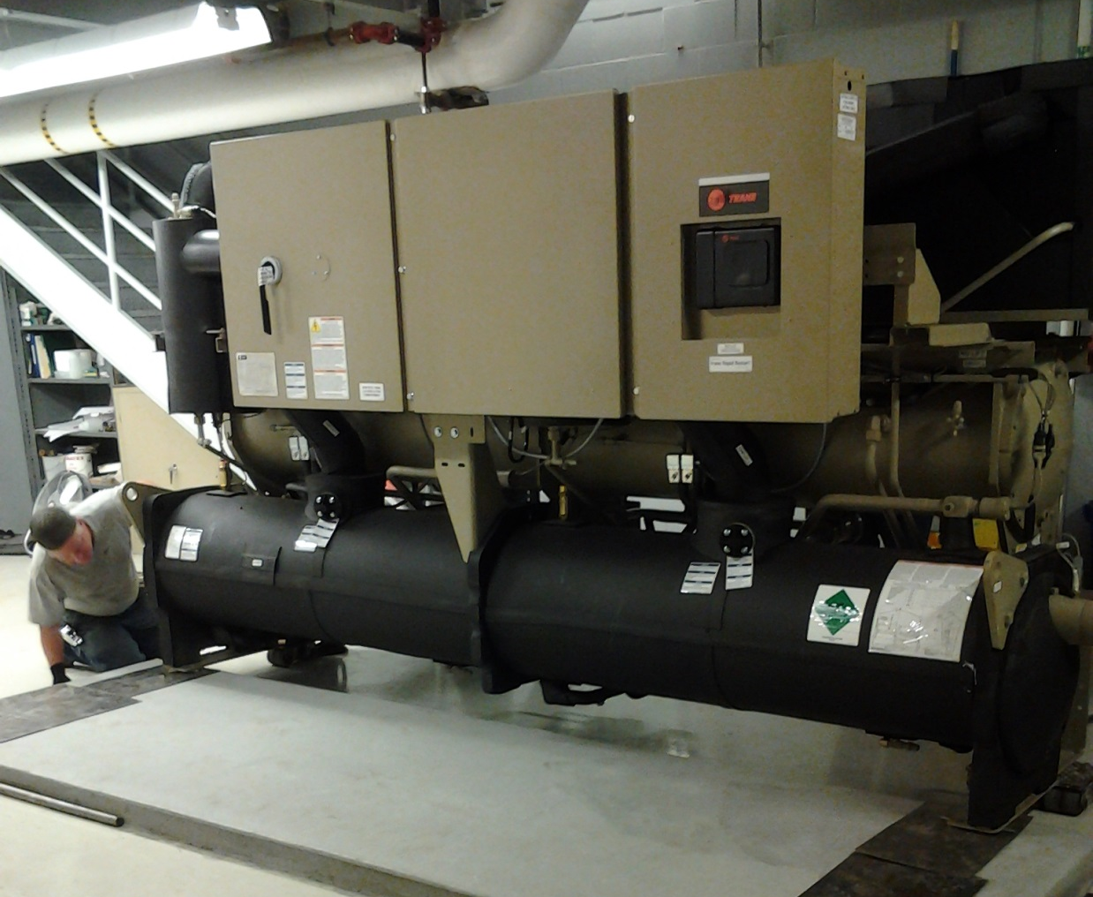

Slide 31
Telephone
Switching

Slide 32
Telephone
Switching
Computer Servers

Slide 33
Elevator
Equipment
Telephone
Switching
Computer Servers

Slide 34
Elevator
Equipment
Telephone
Switching
Computer Servers

Slide 35
Elevator
Equipment
Telephone
Switching
Computer Servers

Slide 36
Elevator
Equipment
Telephone
Switching
Computer Servers

Slide 37
Elevator
Equipment
Telephone
Switching
Computer Servers

Slide 38
Elevator
Equipment
Telephone
Switching
Computer Servers

Slide 39
Elevator
Equipment
Telephone
Switching
Computer Servers

Slide 40
Elevator
Equipment
Telephone
Switching
Computer Servers

Slide 41
Elevator
Equipment
Telephone
Switching
Computer Servers

Slide 42
The Science Museum of Minnesota has reduced its purchases of heat energy by how much through its recent exergy retrofit?
A. 25%
B. 33%
C. 50%
D. 75%
Notes:
Example question, with or without picture
1. Start question, click ok.
2. Have participants click on answers.
3. Click stop.
4. Click once on slide to reveal answer and image (optional).
5. Click display to see results (you may need to move the graph to the blank space on the slide and/or resize it).
6. Click on graph to see correct answer.
7. Click display to hide results.
8. Click slide once to advance.

Slide 43
The Science Museum of Minnesota has reduced its purchases of heat energy by how much through its recent exergy retrofit?
A. 25%
B. 33%
C. 50%
D. 75%
Notes:
Example question, with or without picture
1. Start question, click ok.
2. Have participants click on answers.
3. Click stop.
4. Click once on slide to reveal answer and image (optional).
5. Click display to see results (you may need to move the graph to the blank space on the slide and/or resize it).
6. Click on graph to see correct answer.
7. Click display to hide results.
8. Click slide once to advance.

Slide 45
KWhs/Yr.
Recommissioning 2010
Past 12 months
Forecast

Slide 46
KWhs/Yr.
Recommissioning 2010
Past 12 months
Forecast

Slide 47
KWhs/Yr.
Recommissioning 2010
Past 12 months
Forecast

Slide 48
 | DE FY 2016 NORMALIZED TO DE FY 2013 | Hot Water (MWh) | Steam (MWh) | HW+Steam (MWh) | Chilled Water (MWh) | Electricity (MWh) | Total Annual Energy Consumption (MWh)
Before Retrofit | Oct 2012 thru Sep 2013 | 4,627 | 1,202 | 5,829 | 4,921 | 5,774 | 22,353
After Retrofit | Oct 2015 thru Sep 2016 | 1,174 | 917 | 2,090 | 4,049 | 5,315 | 13,545
 | Reduction | -75% | -24% | -64% | -18% | -8% | -39%

Slide 51
Cost, Savings and Return on Advanced Heat Recovery
$900,000 Purchase, installation and commissioning of heat
recovery equipment

Slide 52
Cost, Savings and Return on Advanced Heat Recovery
$900,000 Purchase, installation and commissioning of heat
recovery equipment
$293,000 Estimated annual savings

Slide 53
Other Complementary Building Improvements

Slide 54
Other Complementary Building Improvements
Direct digital controls upgrade

Slide 55
Other Complementary Building Improvements
Direct digital controls upgrade
CO₂ demand ventilation

Slide 56
Other Complementary Building Improvements
Direct digital controls upgrade
CO₂ demand ventilation
Pneumatic damper actuation conversion

Slide 57
Other Complementary Building Improvements
Direct digital controls upgrade
CO₂ demand ventilation
Pneumatic damper actuation conversion
Continuous commissioning program

Slide 58
factory workers,

Slide 59
factory workers,
truck drivers,

Slide 60
factory workers,
truck drivers,
riggers,

Slide 61
factory workers,
truck drivers,
riggers,
concrete workers,

Slide 62
factory workers,
truck drivers,
riggers,
concrete workers,
electricians,

Slide 63
factory workers,
truck drivers,
riggers,
concrete workers,
electricians,
pipefitters,

Slide 64
factory workers,
truck drivers,
riggers,
concrete workers,
electricians,
pipefitters,
software technicians,

Slide 65
factory workers,
truck drivers,
riggers,
concrete workers,
electricians,
pipefitters,
software technicians,
and many others….

Slide 67
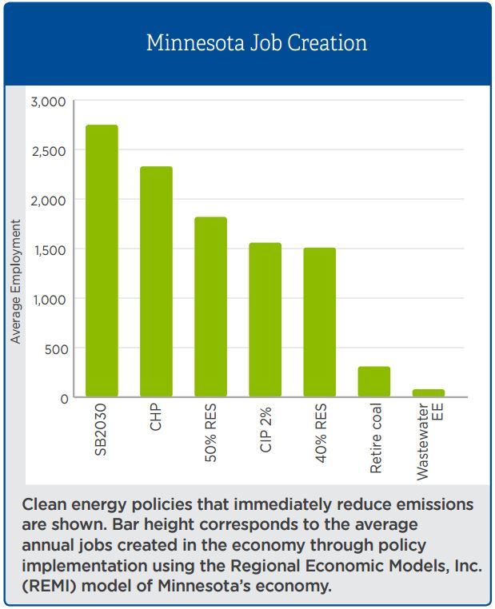

Slide 68
U.S. Energy improvements since 2008
Costs Use
LED lights 90% 195X
Source: U.S. DOE

Slide 69
U.S. Energy improvements since 2008
Costs Use
LED lights 90% 195X
Solar energy 60% 20X
Source: U.S. DOE

Slide 70
U.S. Energy improvements since 2008
Costs Use
LED lights 90% 195X
Solar energy 60% 20X
Wind energy 40% 3X
Source: U.S. DOE

Slide 71
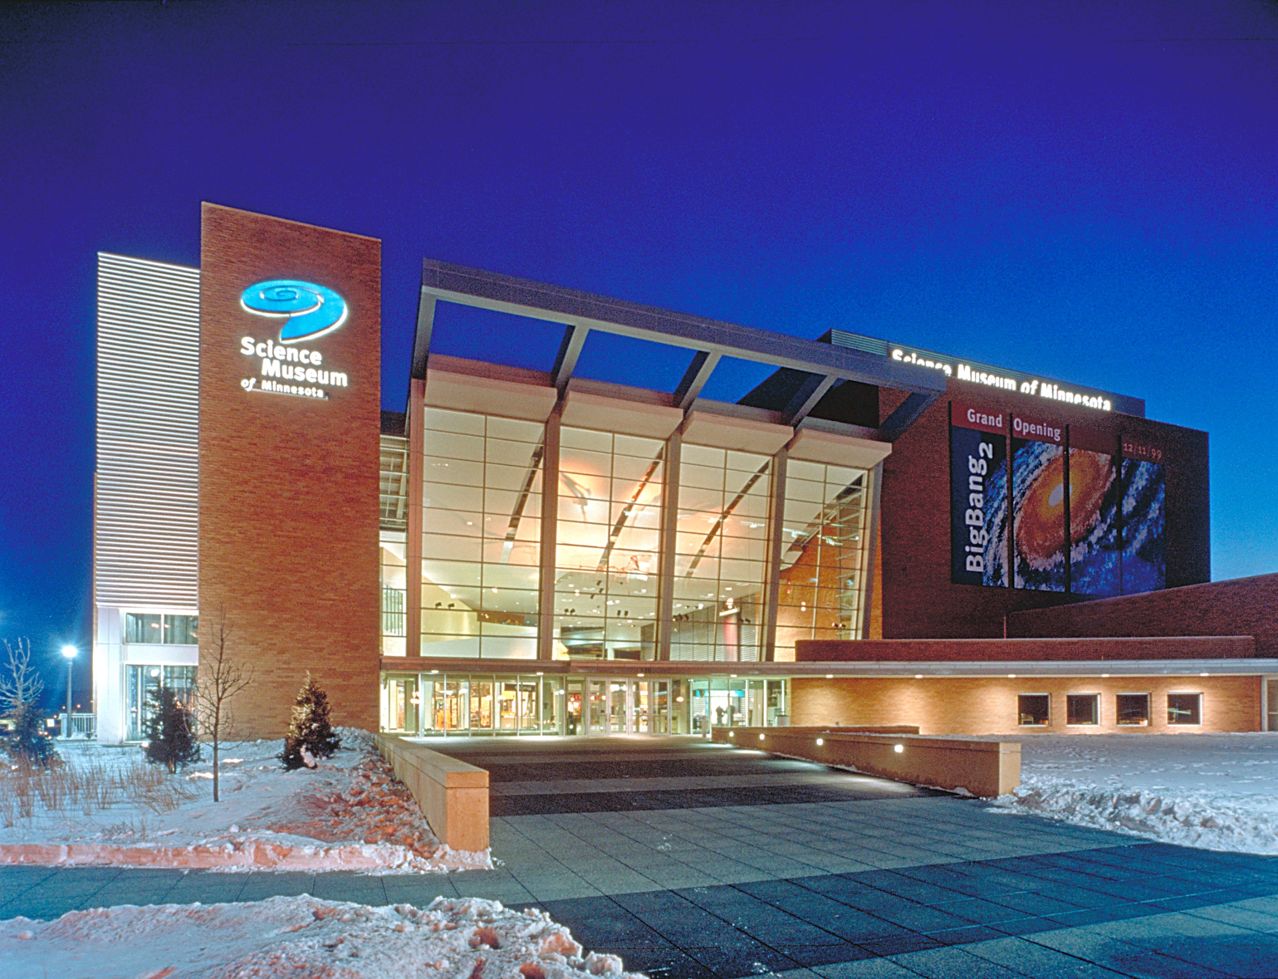

Slide 72
Thank you
Patrick Hamilton
Director, Global Change Initiatives
Science Museum of Minnesota
@PatrickHamilto2
phamilton@smm.org
651-221-4761
Notes:
Example question, with or without picture
1. Start question, click ok.
2. Have participants click on answers.
3. Click stop.
4. Click once on slide to reveal answer and image (optional).
5. Click display to see results (you may need to move the graph to the blank space on the slide and/or resize it).
6. Click on graph to see correct answer.
7. Click display to hide results.
8. Click slide once to advance.

