Slide 1
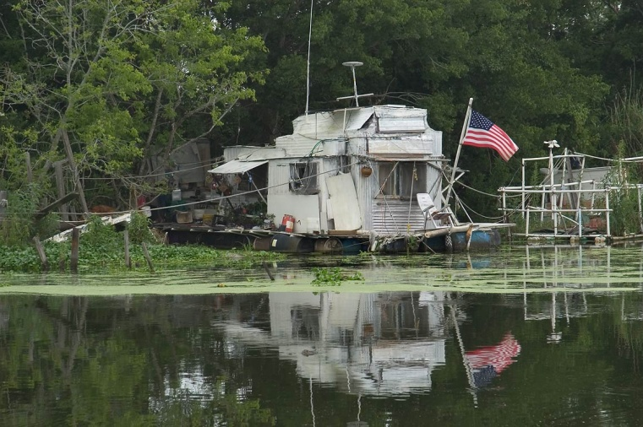
Effective Building Planning & Design

Slide 2
We Don’t Move Fast

Slide 3
Saving Energy

Slide 4
Indoor Air Quality

Slide 5
St. Louis County GSC Schematic Design Schedule:
Meeting 1 | March 8 | Kick-off (Complete)
Meeting 2 | March 15 | Leadership + Stakeholder Discovery Workshop (Complete)
Meeting 3 | May 1 | Leadership Opportunities Workshop + w/ tour of Great River Energy
Meeting 4 | June 7 | All Stakeholder Focus Workshop w/ Tour of Great River + Wilder
Meeting 5 | June 28 | All Stakeholder Summary Presentation
Meeting 6 | July 17 | Board of Commissioners Workshop Presentation
| Concept | Detailed Design + Const Docs | Construction | Operations
Bid
MEETING #6
BIM
Move-In
+
C√+
√
√+
√
√
√
√
C
C√+
Water
Energy
Materials
Function
Economics
BOND
Front-End Loaded Design
+
+
√
C
Calibrated Model(s)
‘In Process’ Feedback Loops are used to progressively inform the solution.
Set / Adjust Project Goals
Project Performance Checkup
Stakeholder Meeting
Legend
Perkins+Will | AIA Minnesota COTE
Board of Commissioners | Summary Presentation

Slide 6
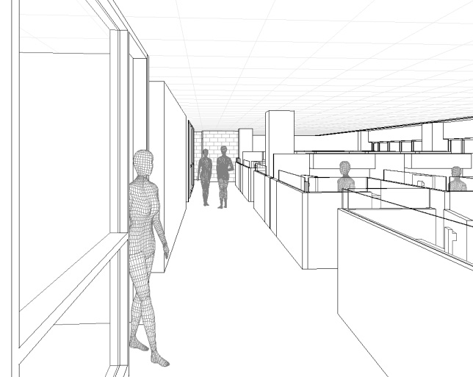
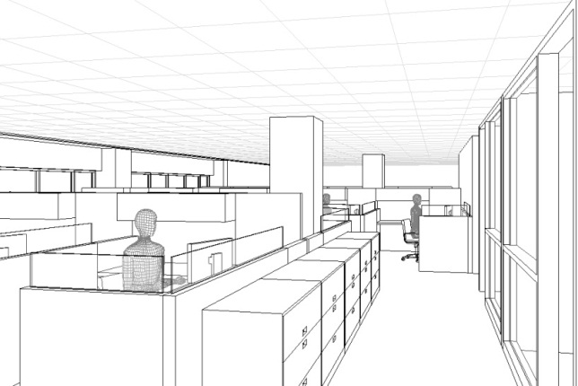
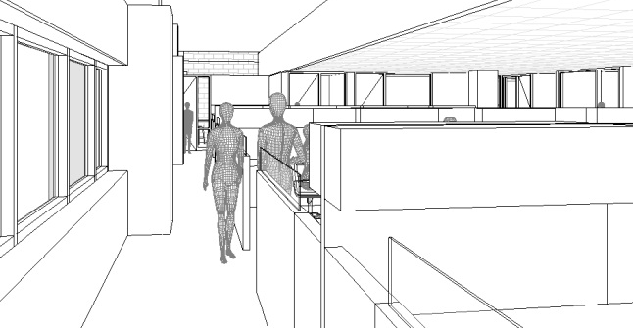
Summary | Project Priorities
Everything You Need, Nothing You Don’t
Efficiently Meet Customer Service Needs
Easy Access to the Variety of Services Provided in
the Building with this Design
Adaptable Standardization to meet Department Needs
Consistent Workspace to Reduce Moves (Save $)
Healthy, Productive, Efficient, Effective
New Life for Building:
- New Mechanicals + Electrical + Infrastructure
- Energy Efficiency: +60% Reduction in Energy Use
- Efficient - Long Life Cycle
Space Planning Priorities:
- Security is crucial: Secure while remaining Welcoming
- Flexible Workplace
- Shared or No Reception / Co-located Departments
- Sunlight w/ Window Views
Virtual Workstation / Flexible Technology

Slide 7
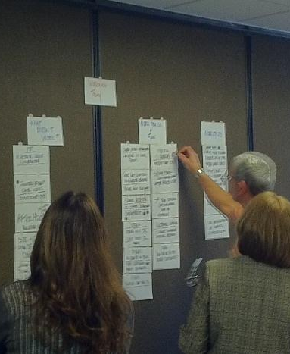
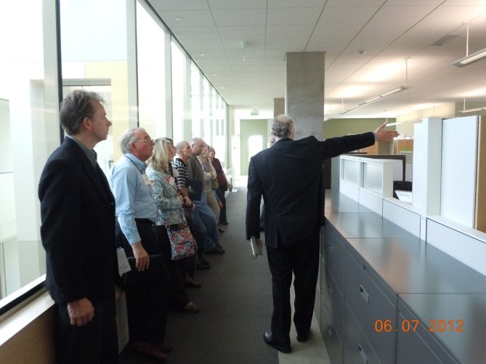
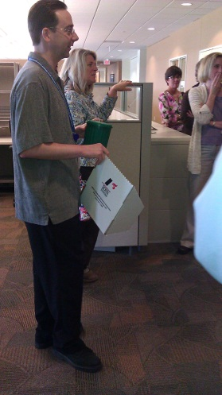
Stakeholder Workshops + Tours
Stakeholder Discovery Workshop
Stakeholder Focus Workshop w/ Tour of Great River + Wilder
All Stakeholder Summary Presentation
Workshops: Department Heads + Property Management
Purpose: Defined Needs of Individual Departments
Define Project Goals
Establish an Appropriate Scope
Tours: Show Example Projects
Show Workspace Solutions
Show Security + Stacking Solutions
Engineering, Architecture + Estimating
On-site Assessments
Schematic Mechanical / Electric Designs w/ Energy Modeling
Conceptual Space Planning and Square Foot Program
Professional Estimating: (3) Rounds
Workstation and Office Sizing
8’6” x 9’-6” Workstation Net Square Feet 62
9’-0” x 13’-0” Closed Office Net Square Feet 121
Occupant Average Useable 177
Key Summary Information
Total Occupants (Less 1st Flr) 457
Estimated Useable Square Feet 80,977 SF
Useable Square Feet / Typical Floor 16,790 SF
Estimated Number of Floors 4.82
Establishing the Project Scope

Slide 8
Modular Layout
- 2 Workstations = Closed Office
- 2 Workstations = Small Conference
- 1 Workstation = Huddle Room
Reception if Closed
Informal Meeting Space if Open
Open or Closed Lobby
Stair
Stair
Elevators
Waiting or Informal Meeting Area
Long Term – Flexibility | Office Space + Elevator Lobby

Slide 9
SHARED AMENITIES
PRIVATE OFFICES
CORE BUILDING
WORKSTATIONS
Design for Energy Efficiency + Health Based Productivity

Slide 10
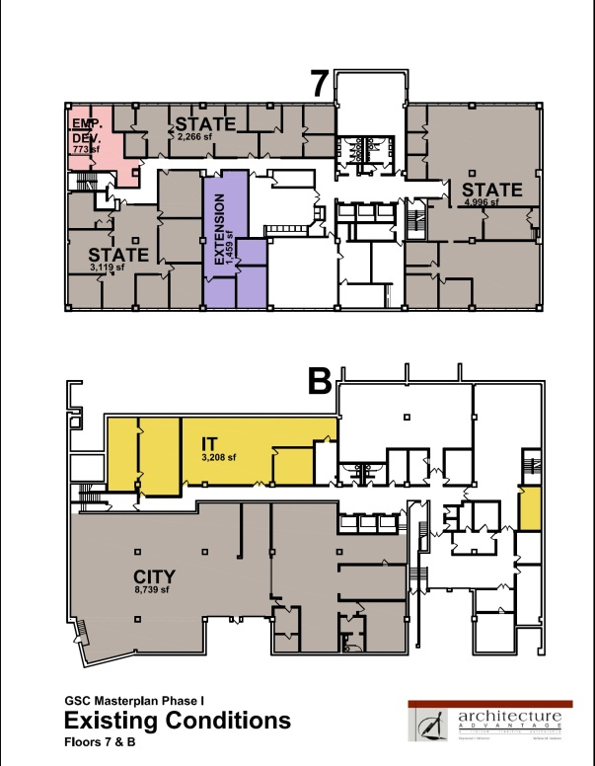
STACKING
Floor 7
Open Lobby
Less Visitors / Less Security
Stair
Elevators
Possible Stacking
Floor 1 | PHHS
Floor 2 | Land, Planning & Environmental
| Training Room
| Extension Office
| (?) Employee Development Office
| (?) PHSS
| (?) Additional Convening Space
Floor 3 | PHHS
| (?) Employee Development Office
Floor 4 | PHHS
Floor 5 | ARVIG
| IT
| (?) PHHS (Small Amount)
Floor 6 | Attorneys
| Safety & Risk
| (?) Employee Development Office
| (?)
Floor 7
Floor 6
Open Lobby?
Floor 6
Staff
Floor 5
Floor 5
Open Lobby?
Floor 4
`
Floor 3
Floor 4
SHELL?
Staff
Visitors
Floor 2
Visitors
Floor 1
Floor 3
Closed Lobby?
Floor L
More Visitors / More Security
Floor 2
Swing Space 13,500 SF
Closed Lobby
LESS DETAIL

Slide 11
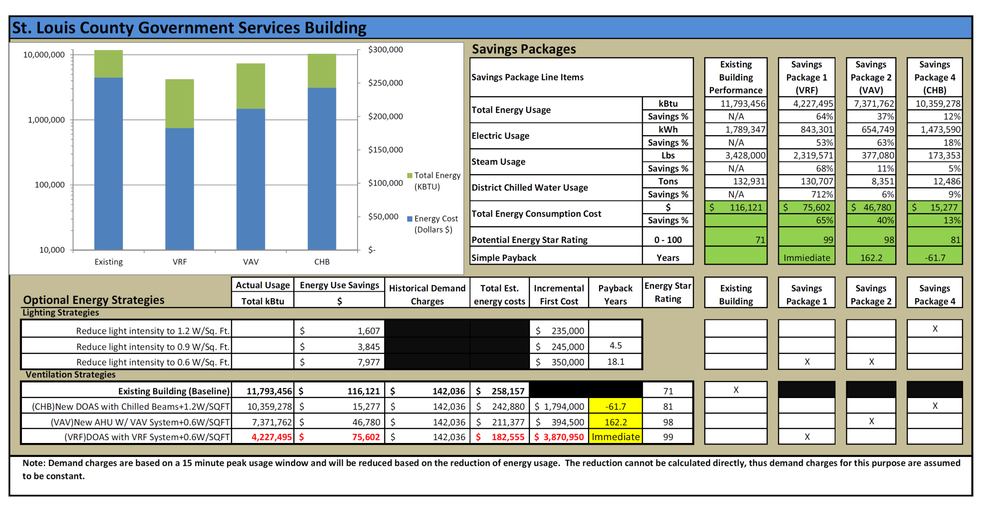
Focus Workshop
Key Summary Information
Existing Building Mechanical + Lighting VAV At End of Life Energy Cost: $116,121
Proposed Mechanical + Lighting System VRF Baseline Cost Energy Savings: $75,602 65%
Updated Version of Existing System VAV ADD: $394,950 Energy Savings: $46,780 40%
Chilled Beam Mechanical System CBM ADD: $1,794,000 Energy Savings: $15,277 13%
Energy Model

Slide 12
St. Louis County GSC Renovation Scope Description
Renovated Mechanical System
Replaced: HVAC System + Building Energy Management System (BAS) + Controls
New VRF (Variable Refrigerant Flow) HVAC system on each floor replacing worn out VAV System
VRF is lower First Cost and better performing with comparable life cycle and maintenance
Renovated: Chiller Main Piping System / Hot Water Radiation
Renovated Electrical System
Cleaned: Main Switch Gear
Renovated: Electric Distribution System / Copper Main Electric Risers Remain
Electric Panel Boards Remain (2 Boards are scrapped for parts and replaced)
Linear Bus Bar extending length of each floor Replaced (Damaged)
New Energy Efficient Lighting System and Controls
Life Safety Systems + Security+ AV
New Emergency Life Safety Alarm System / Stair Pressurization / New Transfer Switch on Emergency Generator
Automated Key Card System provided on Elevator + Electric Locks at Stair doors and Key Security Points
Cat 5 to workstation + Cat 6 to conference rooms
Renovated Interior Office Space Floors 2-7
1 Floor will be Shelled with – (Currently anticipated to be Floor 4)
Modular / Standardized layout providing for long-term ease of space modifications reduced ‘churn’costs
Clear Perimeter: Most Workstations, Office and walls pulled away from exterior wall
Reduces glare and hot/ cold issues + long-term access for maintenance to windows hot water radiation
Basic Construction Interior Construction
Drywall, Paint, Carpet Tile, Painted Steel Door Jambs – Walls Stop at the bottom of the Ceiling
Conferencing Area on Second Floor | Available to All County Employees and other Department Needs
Remodeled Entry Vestibule | Completes First Floor Renovation
Scope Summary | Key Items

Slide 13
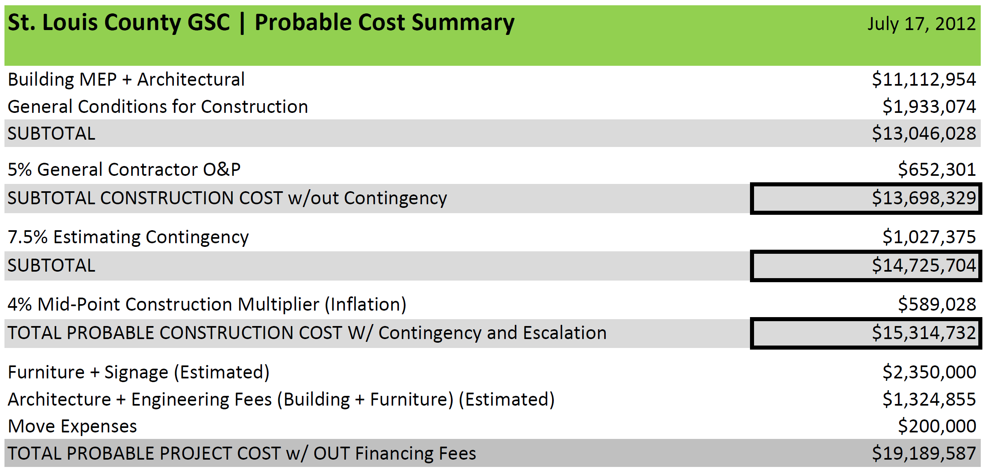
Key Summary Information
Probable Construction Cost with Escalation (Inflation) $15,314,732
Renovation of Space, Mechanical System, Lighting and Electrical System
Floors 2-7 + Remodeled Vestibule
1 Floor to be Shelled (Potentially 4th Floor)
Probable Cost Summary

Slide 14
Project Schedule w/ Construction Phase Close-up

Slide 15
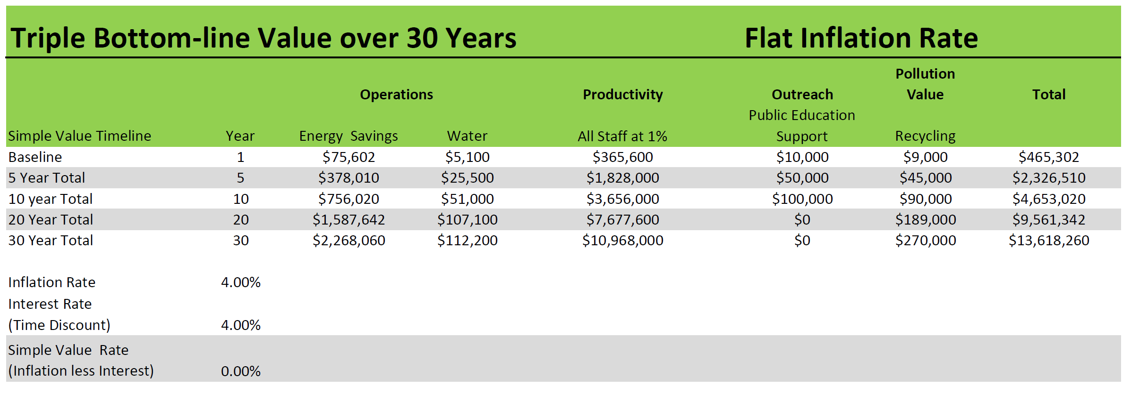
Key Issues Summary
1 Year Energy Savings Value: $75,602
1 Year Water Savings Value: $5,100
1 Year Productivity Value: $365,600
1 Year Outreach Value: $10,000
1 Year Pollution Value: $9,000
1 Year Total Value: $465,302
20 Year Energy Savings Value: $2,326,510
20 Year Water Savings Value: $107,100
20 Year Productivity Value: $7,677,600
20 Year Pollution Value: $100,000
20 Year Outreach Value $189,000
20 Year Total Value: $9,561,342
Value Analysis for Internal Decision Making

Slide 16
Expanded Entryway

Slide 17
Technology - AV

Slide 18
Lighting Controls

Slide 19
Accessible, Bright & Safe Stairwells

Slide 20
Open Space – Local Materials

Slide 21
Perimeter Circulation

Slide 22
Democratic Day-lighting & Views

Slide 23
Unrelated Fact

Slide 24
Questions?

